Slide 1
Real-Time Threat Intelligence
Course : Info Security / Assurance
Team Myntra

Slide 2
Team Members and Roles
Role | Name(s) | Responsibilities
Back-End Developer | Harika Alla, Chandini Marrapu | Implements API integrations, builds risk scoring algorithms.
Front-End Developer | Hema Sri Vemuri | Develops UI/UX for real-time intelligence dashboard.
Risk Analyst | Hemanth Bola, Deepika Panjala | Conducts TVA mapping, risk assessments, and risk mitigation planning.
Git Administrator | Rajendra Gudimetla | Manages repository, documentation, and version control.

Slide 3
Introduction & Project Objectives
Our project, "Real-Time Threat Intelligence," delivers an integrated cybersecurity platform designed to provide proactive threat detection and automated risk mitigation. Using a robust technology stack comprising Node.js (Express.js) for the backend, React.js for a dynamic frontend, PostgreSQL for secure data management, and OSINT integrations (Shodan, SecurityTrails, Hunter.io), our system harnesses real-time intelligence to identify vulnerabilities swiftly. By leveraging advanced AI-driven risk analysis via Hugging Face's LLM, the platform offers predictive threat assessments and adaptive defense strategies, significantly enhancing the cybersecurity posture and operational resilience of the organization.

Slide 4
Objectives of project
Develop a real-time threat intelligence system that proactively detects and mitigates cyber threats using integrated OSINT tools (Shodan, SecurityTrails, Hunter.io).
Implement advanced threat detection and risk assessment leveraging Hugging Face LLM for predictive analytics and anomaly identification.
Establish automated incident response and blue teaming capabilities, including dynamic IP blocking, automated alerts, and countermeasures aligned with NIST cybersecurity guidelines.
Conduct comprehensive security testing and optimization, ensuring robust performance under high load conditions, maintaining compliance with OWASP and NIST security standards.
Provide clear and actionable threat visualization through a React.js-based interactive dashboard, offering immediate insights and facilitating rapid decision-making.

Slide 5

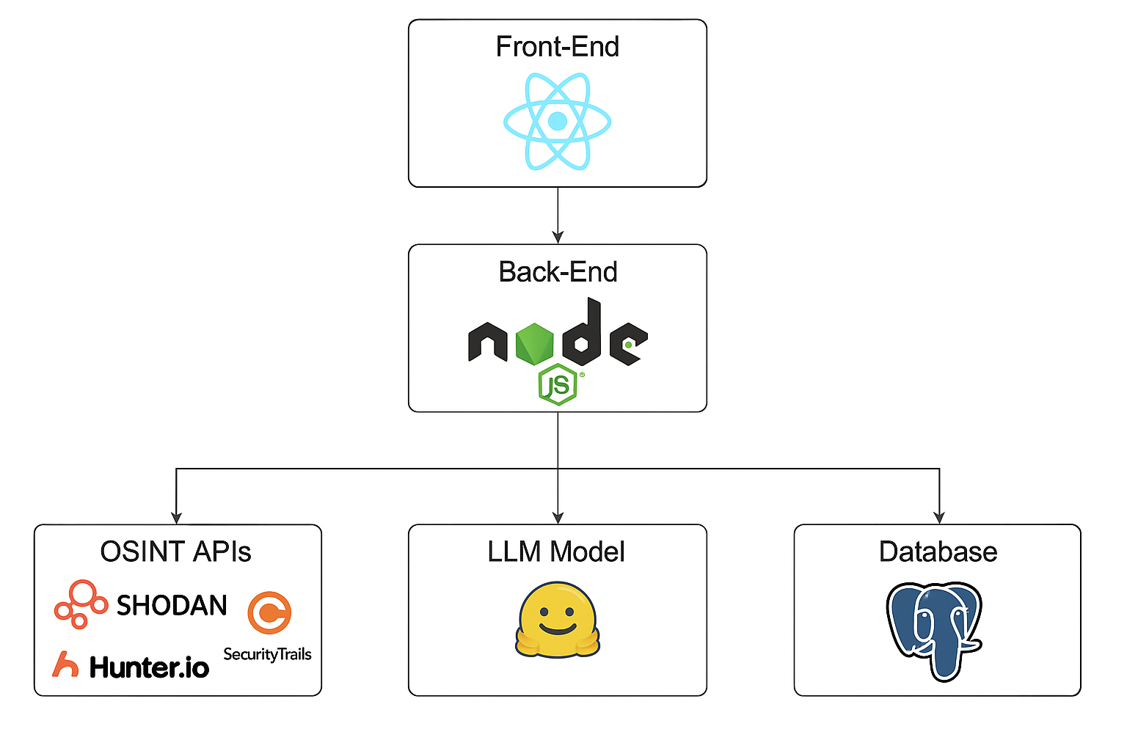
Technologies Used

Slide 6
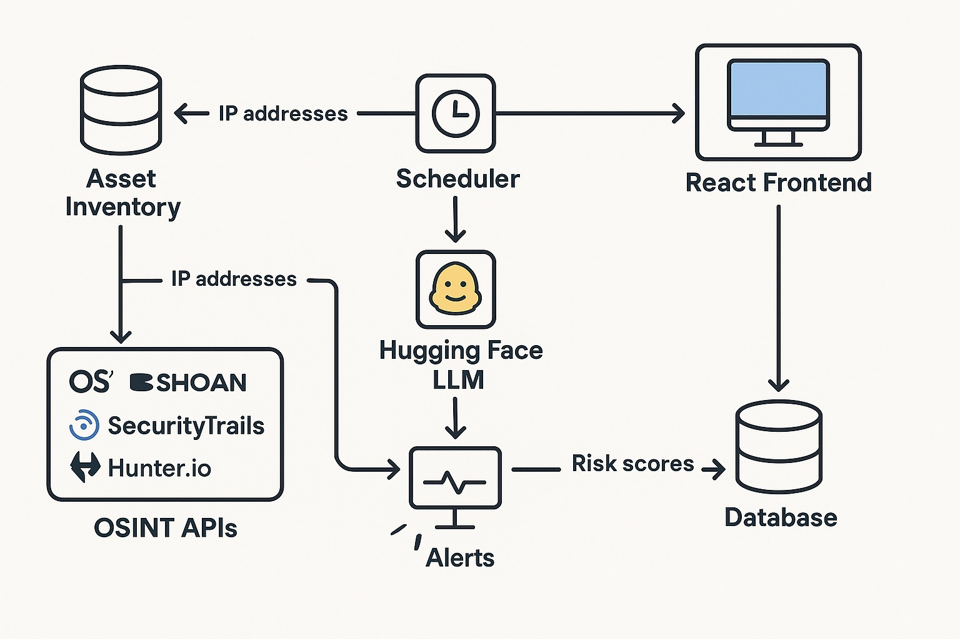
System Architecture

Slide 7
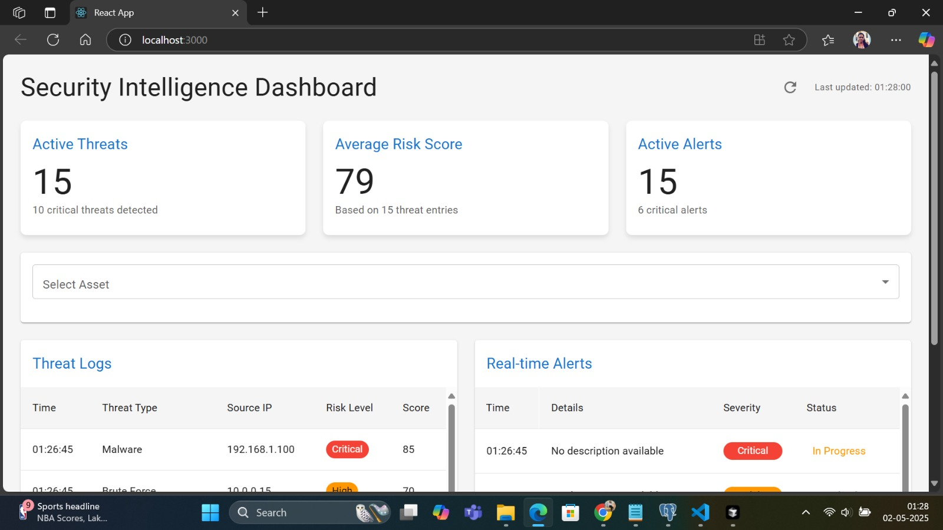
Live Demo

Slide 8
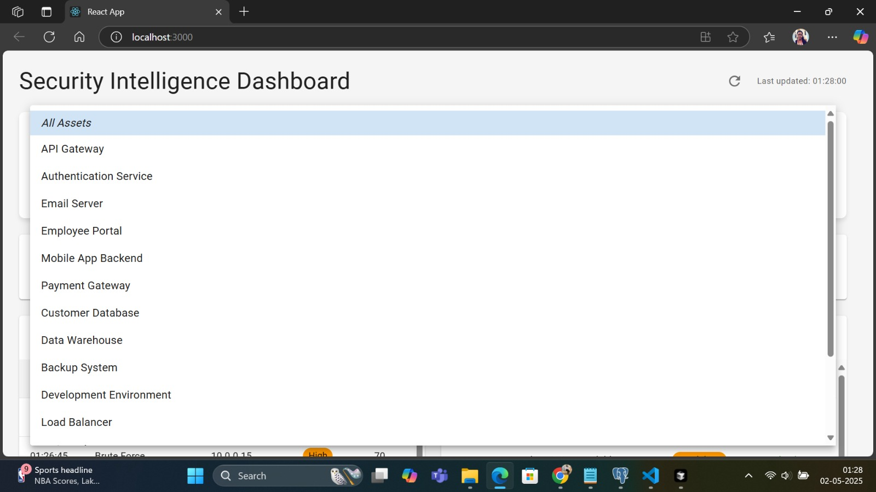
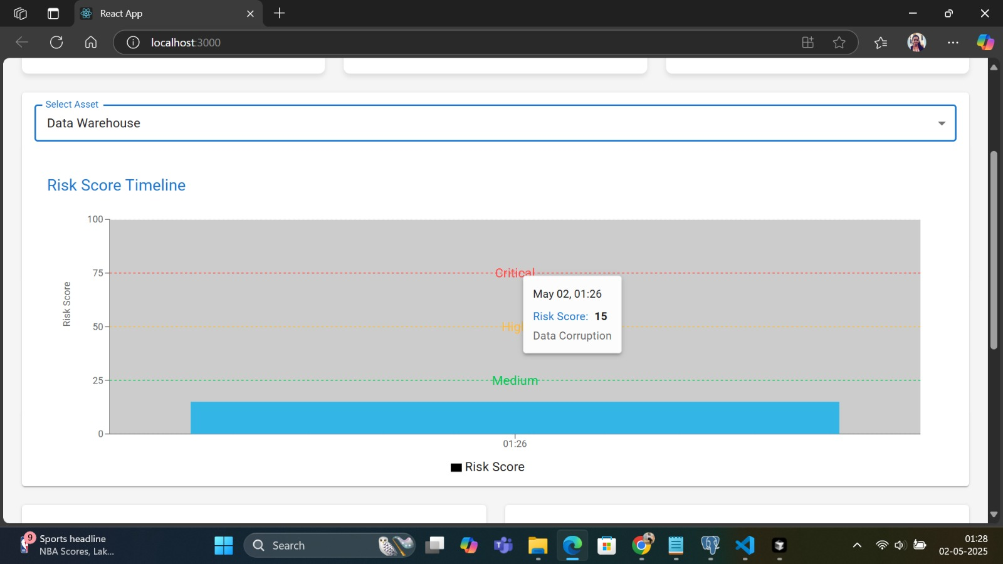

Slide 9
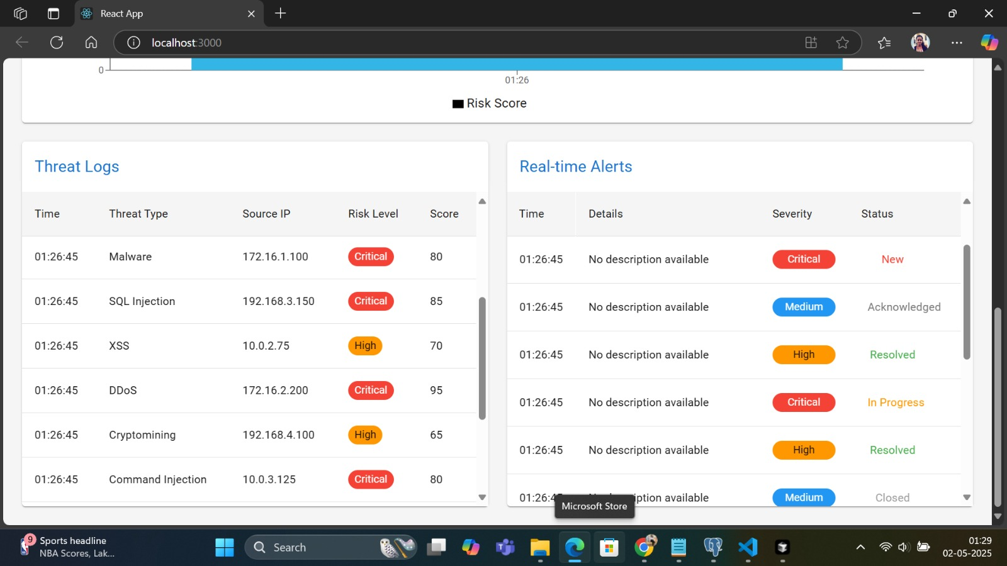

Slide 10
Security Features
Real-Time Threat Detection Leverages OSINT APIs (Shodan, Hunter.io, SecurityTrails) to monitor vulnerabilities continuously.
AI-Powered Risk Scoring Uses Hugging Face LLM to dynamically assess threat severity and predict potential attack vectors.
Automated Alerts & Response Triggers email/webhook alerts for threats exceeding a risk threshold (e.g., Risk Score > 20).
Blue Teaming Integration Implements auto-blocking of IPs and suggests countermeasures aligned with NIST incident handling practices.

Slide 11
Risk Management Approach
Threat-Vulnerability-Asset (TVA) Mapping Aligns each identified threat with affected assets to prioritize responses.
Incident Response Workflows Predefined plans for SQL Injection, Phishing, and DDoS attacks to minimize response time.
Cost-Benefit Analysis (CBA) Evaluates the financial justification for security controls using ALE-based calculations.

Slide 12
Testing & Evaluation Metrics
Security Testing
Conducted vulnerability assessments using OWASP ZAP, Burp Suite, and Nmap.
Identified and mitigated issues like open ports, weak headers, and input injection flaws.
Performance & Load Testing
Used Apache JMeter to simulate concurrent API requests and assess system load capacity.
Optimized response time and reduced database query latency with indexing and SQL tuning.

Slide 13
Challenges
API Rate Limiting & Authentication
Frequent restrictions from OSINT APIs like Shodan and Hunter.io during high-volume queries.
Model Output Latency
Hugging Face LLM calls introduced delays in real-time threat scoring.
Data Integration Complexity
Parsing and normalizing heterogeneous data formats from multiple APIs was inconsistent.
False Positives in Threat Alerts
Initial detection logic led to over-alerting for low-impact threats.
Database Performance Under Load
PostgreSQL response times slowed with large datasets and unoptimized queries.

Slide 14
Solutions
API Throttling & Caching
Introduced Redis caching to store API results temporarily and reduce redundant requests.
Async Processing for LLM
Shifted AI-based scoring to asynchronous queues to avoid front-end blocking.
Data Normalization Layer
Created unified threat object schemas for consistent ingestion across all APIs.
Risk Threshold Tuning
Fine-tuned risk scoring logic and thresholds to suppress false alerts.
Query Optimization & Indexing
Applied indexing on frequently queried columns and optimized SQL queries for faster access.

Slide 15
Future Improvements
Integration with SIEM Tools Connect the platform with industry-standard tools like Splunk or ELK Stack for enterprise-grade log correlation and alerting.
Multi-Model AI Support Incorporate additional LLMs (e.g., GPT-4 Turbo, Claude) for comparative risk assessments and enhanced threat predictions.
Threat Attribution Engine Develop logic to identify threat actors or groups based on behavior patterns and historical data.
User Access Control & Audit Logs Implement granular role-based access control (RBAC) and maintain detailed logs for compliance and monitoring.

